Slide 1

Team Details
Team Name: Colossus Squad
Team Leader Name: Amruthamsh A
Problem Statement: How might we incorporate Normalized difference vegetation index and Deep Learning to assist and upskill farmers without smartphones or computers to improve agriculture productivity and enhance crop health through a comprehensive, data-driven approach?

Slide 2
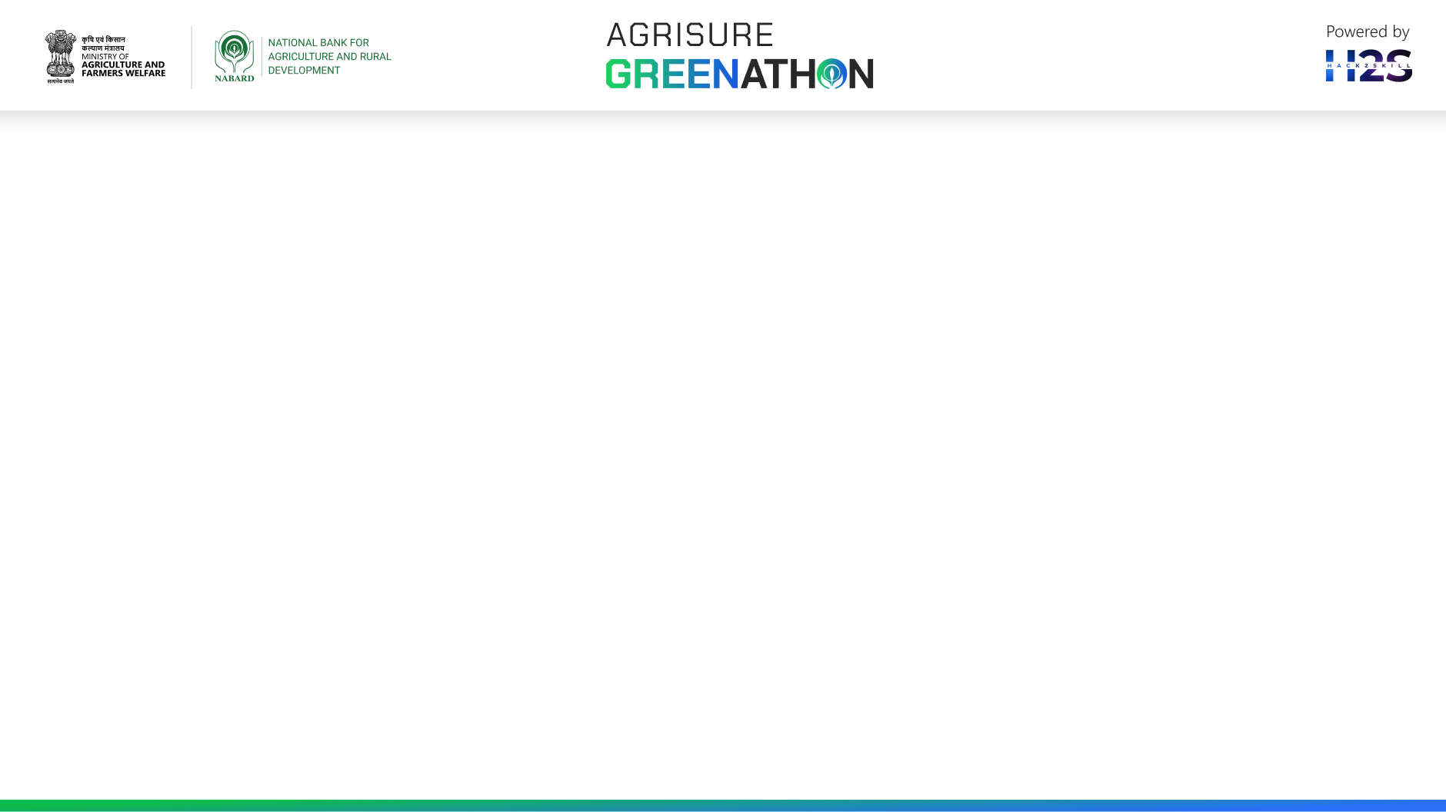
Brief about the idea
A standalone-interactive Kiosk (built using rugged-repurposed Tablets or LCD displays) which is situated in a centralized location which can be used and shared between multiple farmers around that area. The sensor data, NDVI data, latest updates of government schemes, agricultural practices can be learnt from this multifunctional Kiosk. The device utilizes deep learning for real-time plant disease detection, providing actionable insights for effective and inclusive crop management. This integrated platform empowers farmers with the tools, knowledge, and strategies needed for sustainable, productive, and innovative farming practices.
Designed to be multilingual and cost-effective, the Kiosk ensures that farmers from diverse linguistic backgrounds can access vital information and resources. It also includes skilling modules to educate farmers on modern agricultural techniques, fostering greater inclusion and knowledge-sharing within the community.
Additionally, the kiosk is equipped with a removable camera device and sensor device, secured to the central Kiosk with location tracking. This device can be taken into the fields for detecting plant abnormalities or diseases, with the data seamlessly synced and stored back in the central kiosk. This integrated platform empowers farmers with the necessary tools, knowledge, and strategies for sustainable, innovative, and productive farming practices.

Slide 3
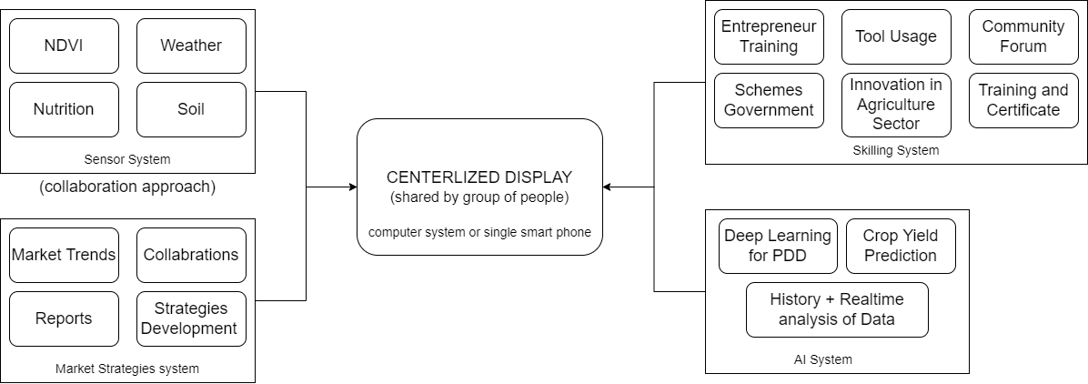
Brief about the idea
Fig. 1: Overall Proposed Methodology

Slide 4
x
How will it be able to solve the problem?
High Cost Tools: Develop a centralized platform for sharing NDVI tools and sensor data, reducing individual costs and promoting collaborative use.
Limited Access to Agricultural Information: Create a search engine and an easy-to-use Kiosk offering tailored agricultural information, interactive training modules, and regular updates on government schemes and agricultural best practices.
Market Losses and Inefficiencies: Provide tools for developing collaborative, market-specific strategies with data analytics to minimize losses and optimize logistics.
Delayed Plant Disease Detection: Utilize deep learning models for real-time plant disease detection via mobile apps, offering instant, actionable insights for effective crop management.
Skilling and Empowerment: Offer multilingual training through a web app/or standalone Kiosk, empowering farmers with the skills and knowledge to implement advanced agricultural practices.

Slide 5
How different is it from any of the other existing ideas?
Comprehensive Integration: Combines NDVI, deep learning, and agricultural management tools, unlike Farmers Edge and Climate FieldView, which only focus on one aspect.
Cost-Effective Resource Sharing: Facilitates sharing of NDVI and sensor data amongst farmers via a centralized system approach, a feature not found in Sentera and other similar solutions.
Multilingual Training and Market Strategies: Offers multilingual agricultural training and market-specific strategies, unlike Granular and CropIn, which lack these comprehensive features.
USP of the proposed solution
Holistic Integration: Combines NDVI, deep learning, and collaborative tools in one centralized platform.
Centralized Kiosk: Cost-effective, shared hub for multiple farmers.
Advanced Deep Learning: Real-time plant disease detection and insights.
Multilingual Support: Accessible in multiple languages for diverse users.
Skilling Opportunities: Educates farmers with modern techniques and strategies.

Slide 6
List of features offered by the solution
Search Engine and Agricultural Skilling (Multilingual Web App):
Create a multilingual web app within the centralized Kiosk for agricultural training and information.
Features:
Customized Search: Algorithms prioritizing agricultural content.
Knowledge Base: Comprehensive database with articles, research papers, and guides.
Updates on Government schemes and new agricultural practices.
2. Centralized Approach (Shared NDVI Tools and Resources):
Develop a platform for centralized NDVI tools and resources.
Features:
NDVI Data Collection: Use of sensors and other IoT devices.
Data Sharing: System for sharing NDVI data among farmers.

Slide 7
List of features offered by the solution
3. AI (Deep Learning) approach for Plant Health
Incorporate deep learning models for disease detection.
Features:
Image Analysis: CNNs to analyze plant images for disease detection.
Real-Time Monitoring: Systems using mobile apps or IoT devices.
Decision Support: Actionable insights and recommendations based on disease detection.
4. Market-Specific Agricultural Approach (Collaborative Loss Reduction)
Develop strategies for market-specific agricultural practices.
Collaborative Platform: Platform for market-specific strategy collaboration.
Data Analysis: Use data analytics to identify market trends and recommendations.
Supply Chain Integration: Optimize logistics and reduce waste through supply chain systems.

Slide 8
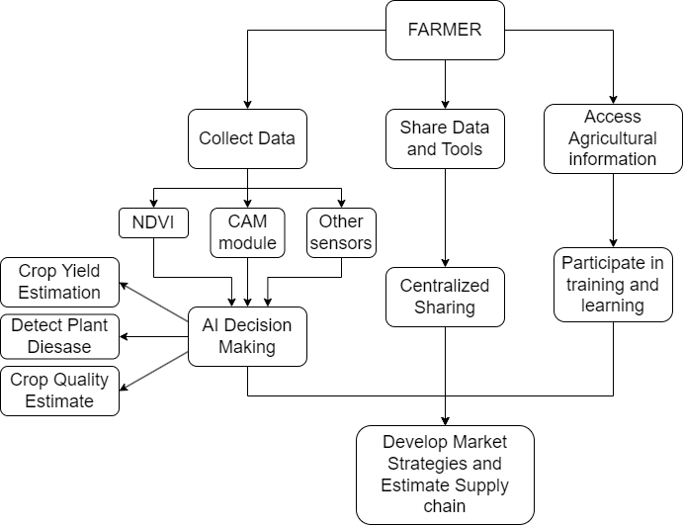
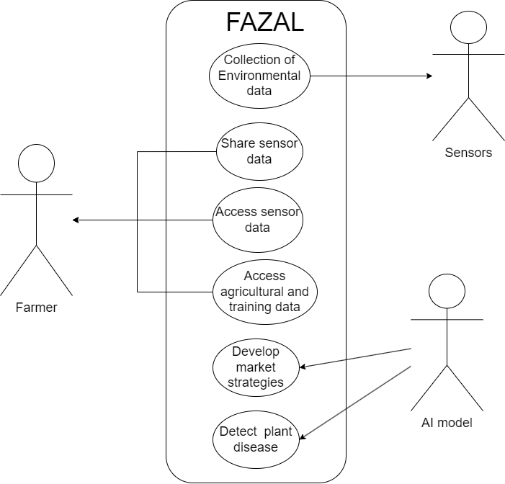
Process flow diagram or Use-case diagram
Fig. 2: Process flow diagram
Fig. 3: Process flow diagram

Slide 9
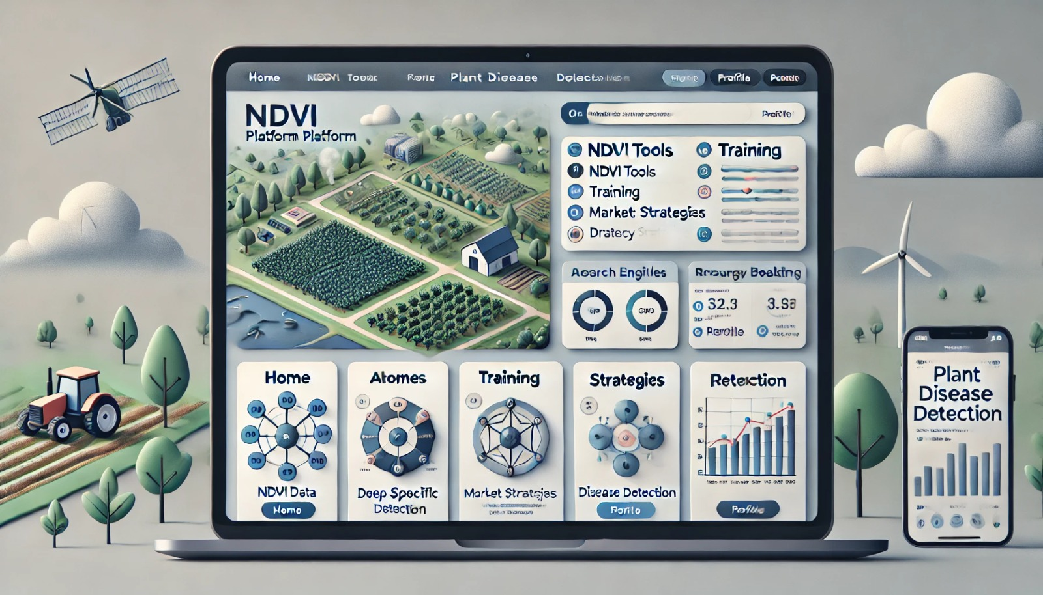
Mock diagram of the proposed solution
Fig. 4: Mock diagram

Slide 10
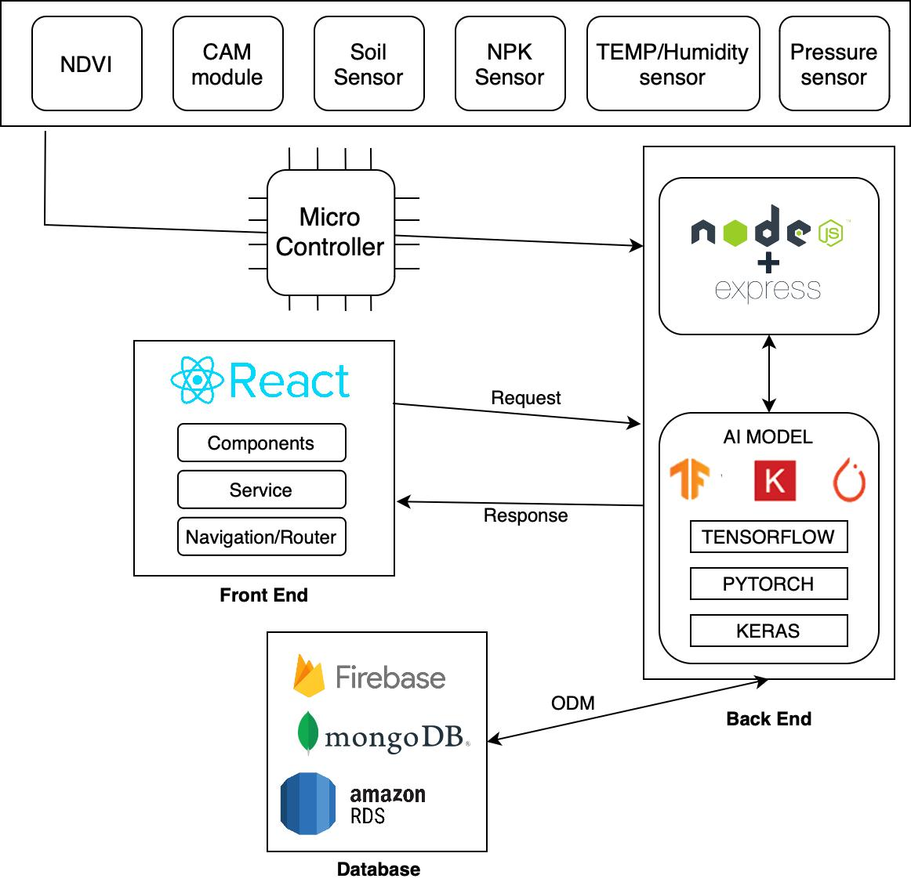
Architecture diagram of the proposed solution
Centralized Data Management: All sensor data, including NDVI, soil health metrics, and environmental conditions, are processed and managed through a central kiosk system. This centralized approach allows for effective data sharing and integration, enabling multiple farmers to access insights and analytics from a single platform.
Integrated AI and Machine Learning:The system utilizes advanced AI algorithms, powered by TensorFlow, PyTorch, and Keras, to analyze the data collected. This setup facilitates real-time plant disease detection and provides actionable insights directly to farmers, enhancing decision-making and crop management through a shared, centralized platform.
Fig. 5: Architecture diagram

Slide 11
Technologies to be used in the solution
Display: Repurposed Tablets, smartphones, LCD Displays
Microcontroller: ESP32, ESP32 CAM
Sensors:
AS7263 Sensor, LED Sensor – NDVI data
SEN6 Soil Hygrometer
AHT20 / DHT11 – Temp and Humidity
BMP-280 – Pressure Sensor
Soil NPK Sensor – Nutrition Sensor
Frontend: React, React-Native
Backend: Node.js, Flask
Database: MongoDB, RDS
AI: Tensorflow, Keras, PyTorch
Data Sources: http://rs.ipb.uni-bonn.de/data/growliflower/index.html
https://huggingface.co/datasets/KaraAgroAI/Drone-based-Agricultural-Dataset-for-Crop-Yield-Estimation
https://www.data.gov.in/sector/Agriculture
https://www.kaggle.com/discussions/general/446746
https://www.kaggle.com/datasets/vipoooool/new-plant-diseases-dataset
https://paperswithcode.com/dataset/plantdoc

Slide 12
Estimated implementation cost (optional)
Repurposed Tablets, Smartphones, LCD Displays: Opt for the most cost-effective option. Estimate: ₹3,000 - ₹5,000 for a basic setup.
Microcontroller (ESP32, ESP32 CAM): ₹500 - ₹1,000 each (use fewer units).
Sensors:
AS7263 Sensor: ₹3,000 - ₹4,000 each.
SEN6 Soil Hygrometer: ₹200 - ₹500 each.
AHT20 / DHT11 Temp and Humidity Sensor: ₹200 - ₹300 each.
BMP-280 Pressure Sensor: ₹100 - ₹200 each.
Soil NPK Sensor: ₹ 5,000- ₹ 6,000 each
Miscellaneous: Limit expenses for project management and testing.
Estimate: ₹2,000 - ₹3,000.
Total Estimate: ₹14,000 - ₹20,000

Slide 13


